Slide 1
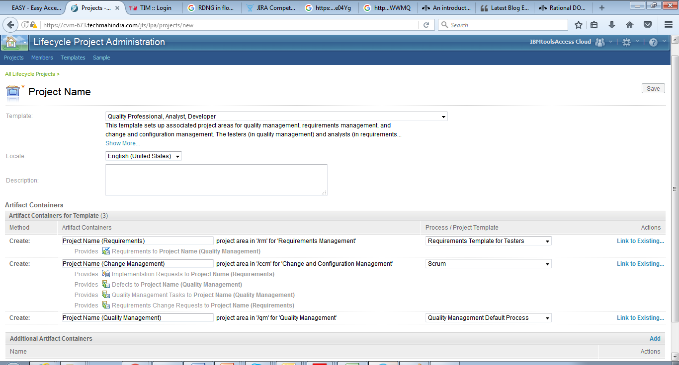
Project Creation Based on Template
Jazz Team Server Administration
Create Lifecycle Project

Slide 2
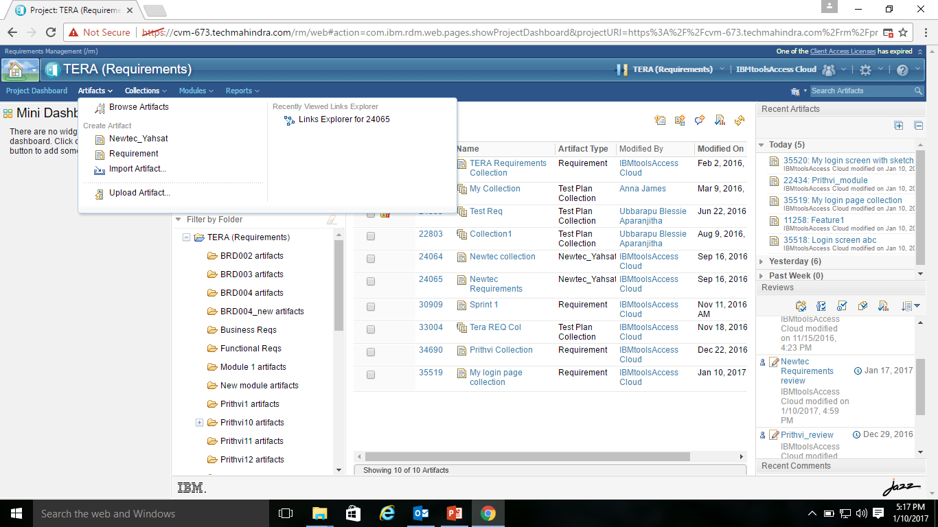
Artifacts
Upload Artifact

Slide 3
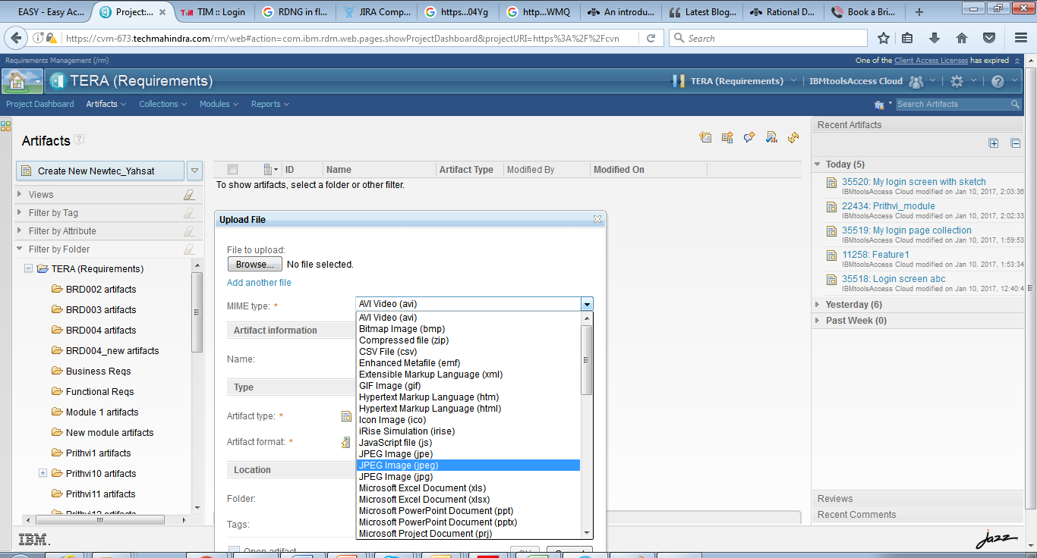
Uploading a document

Slide 4
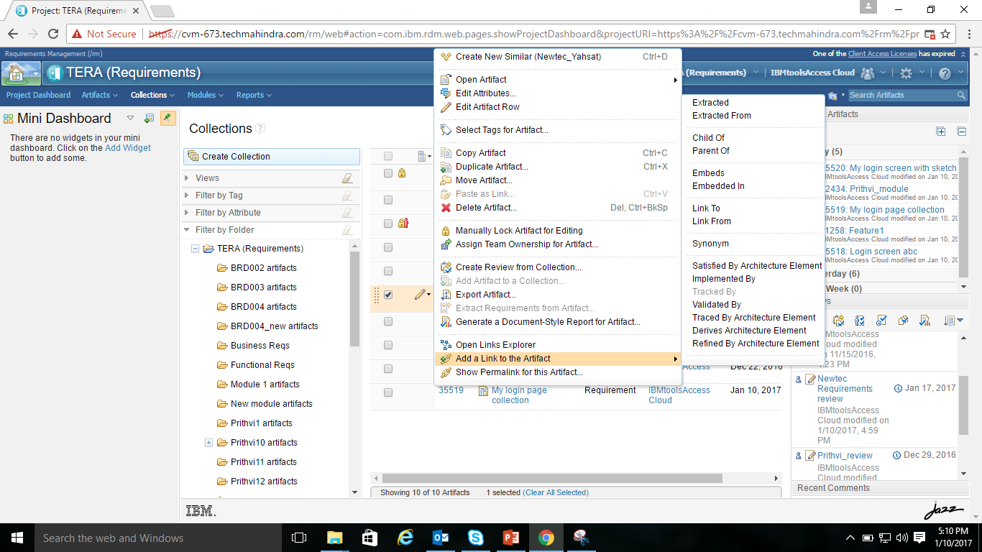
Select a requirement artifact
Click on the pencil icon on the left hand side

Slide 5
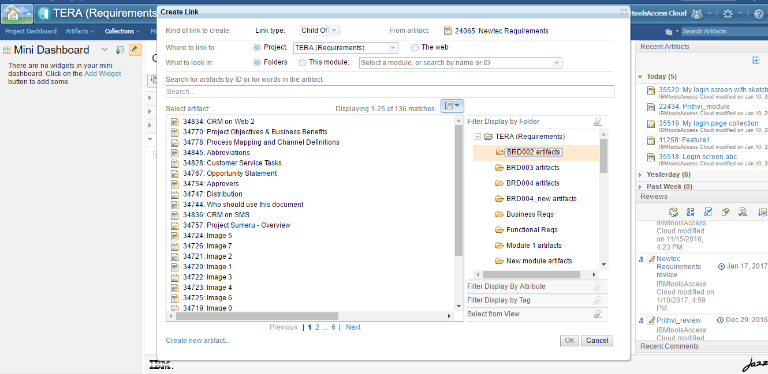

Slide 6
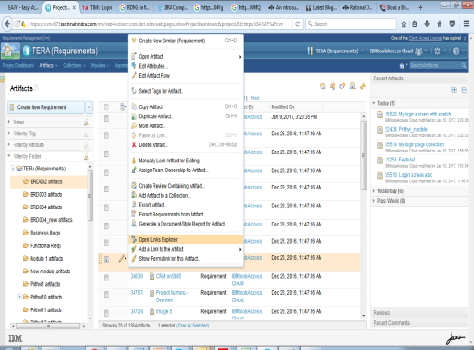
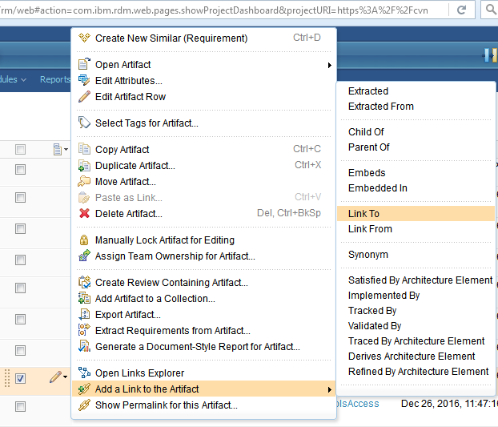
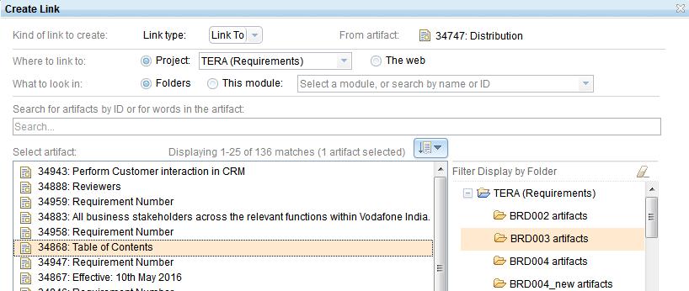
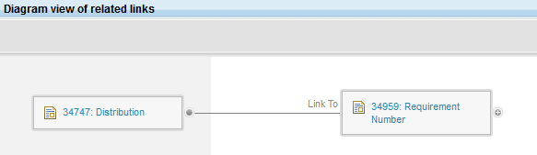
LINKING and VIEW

Slide 7
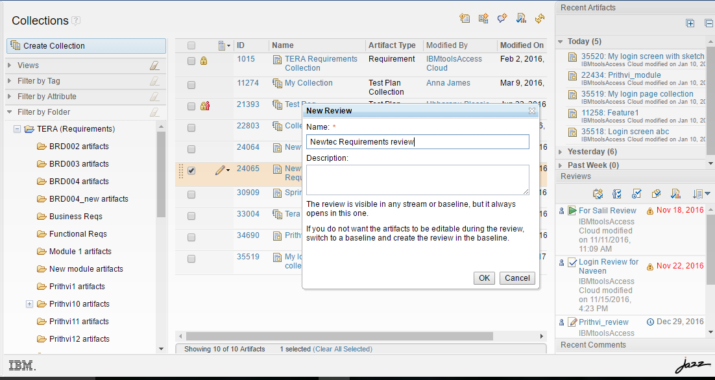
Click on the icon highlighted in square outline to generate a review

Slide 8
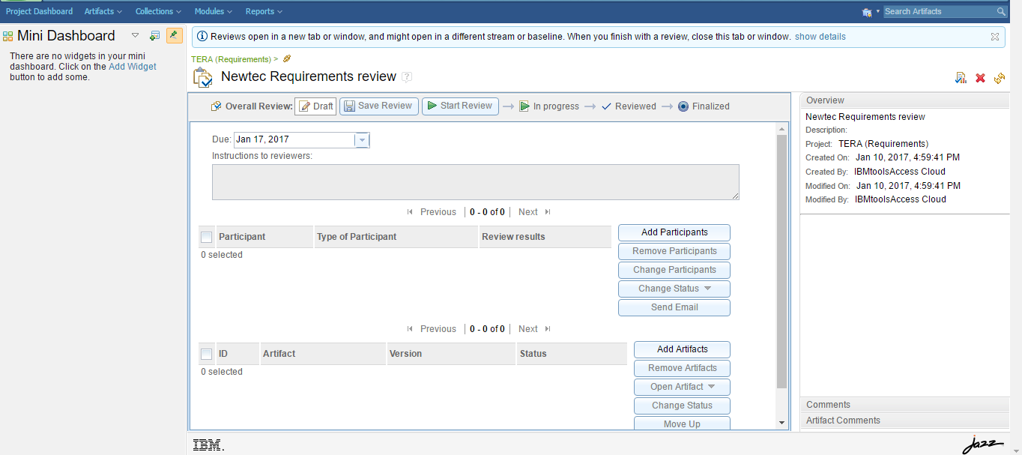

Slide 9
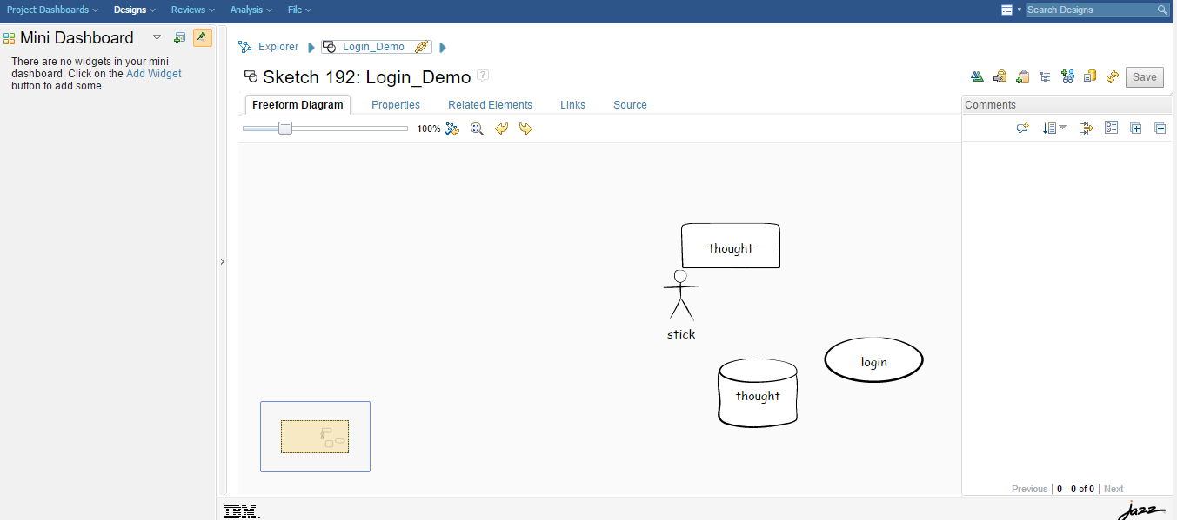
Creating use case sketch diagrams

Slide 10
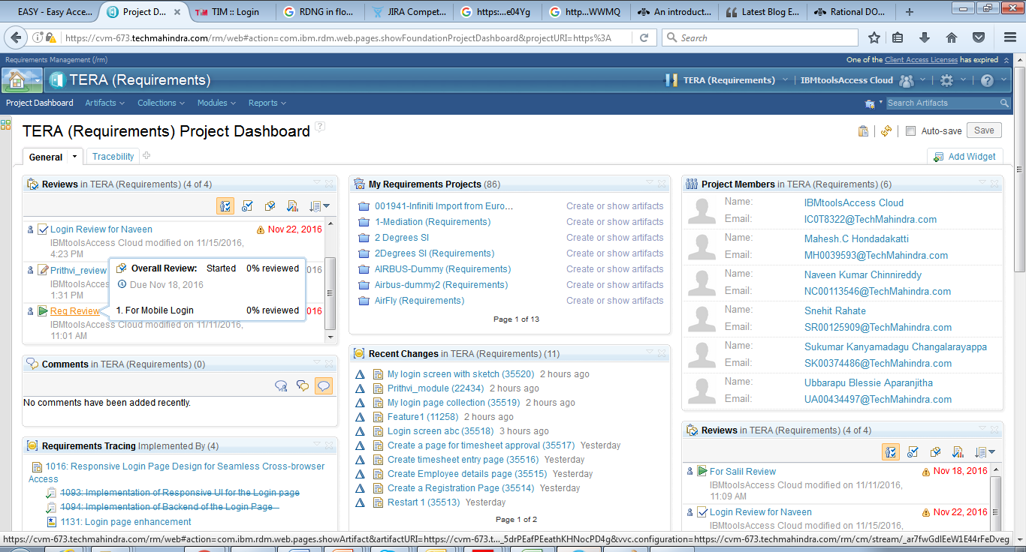
Project Dash Board

Slide 11
Thank you

